Slide 1

Audio
signal
Processing

Slide 2
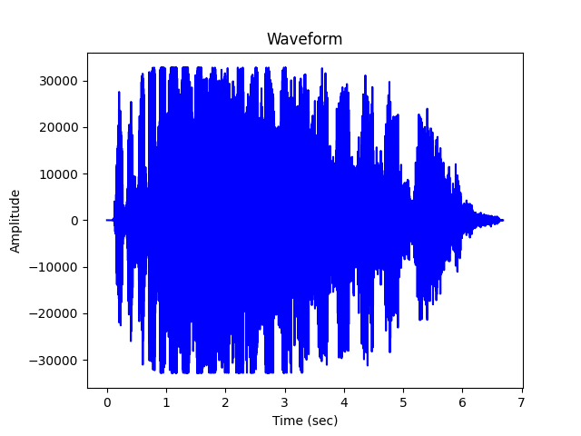

Original wave
We will open the wav file using wave library.
It will read the number of frames and sample rate and convert the x-axis to the time using the following equation: $\text{time}\text{=}\text{len}\text{(}\text{raw}\text{)/}\text{sampleRate}$
Then plot the wave by giving the y-axis the amplitude which is the number of frames and the x-axis the time, as the following example:

Slide 3
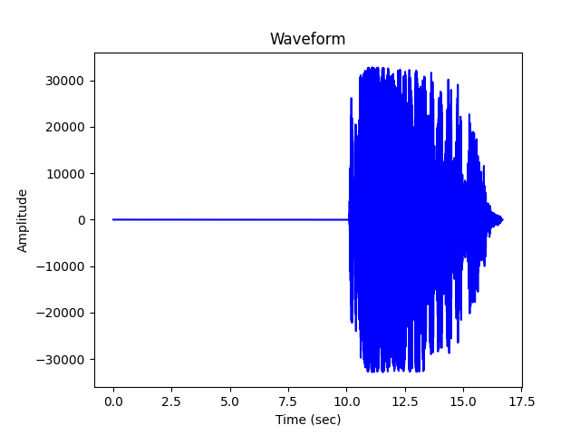
Time Shifting
The user will ask for the time shifting value as showing on the frontend.
It will operate the value according to:
If the value<0 it will shift the wave to the right side so it will add a silent duration for AudioSegment library as the following example:

Slide 4
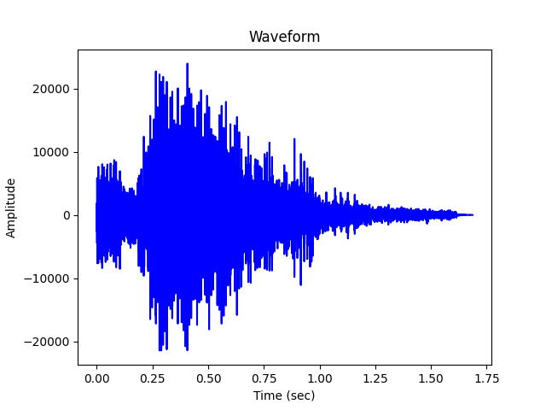
If the value>0 it will shift the wave to the left side so it will cut the time before the specific second.
The audio will be from the specific second to the end second only which is the length of the audio as the following example:

Slide 5
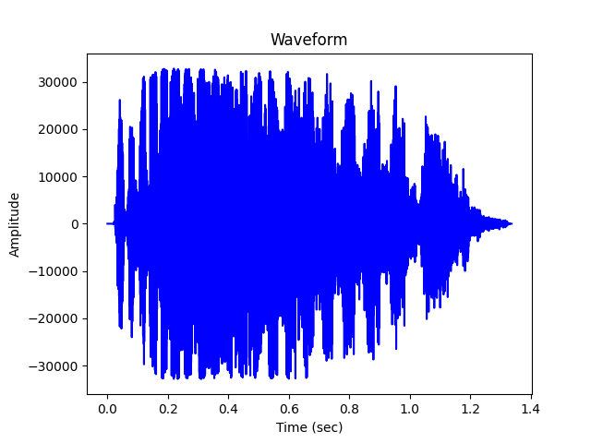
Time Scale
The user will ask for the time scale value as showing on the frontend.
There is a condition with function to avoid the zero value if the user put the zero value which is the initial value it will operate as value=1.
Otherwise it will operate the value according to the following:
If the value>1 it will compress the audio signal.

Slide 6
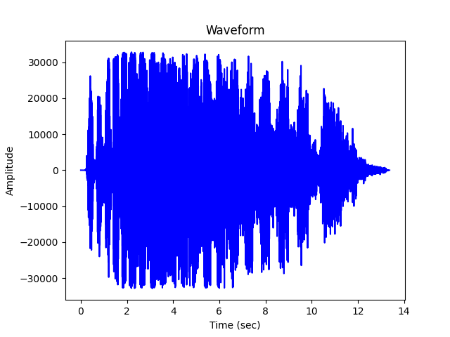
If the value<1 it will expand the audio signal.

Slide 7
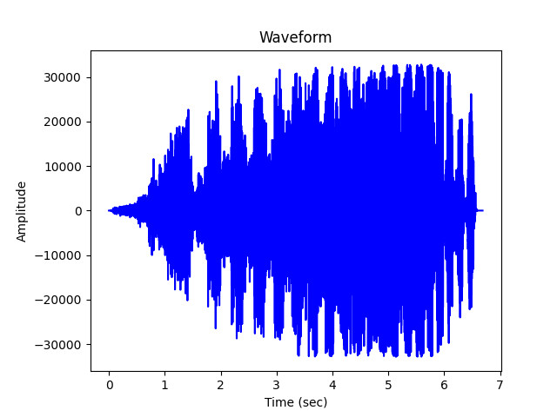
Time Reverse
As shows on the frontend if you pressed the on button it will reverse the element of array.
we used a built-in function called reverse() in the AudioSegment library, as the following example:

Slide 8
Modified Wave
The sequence of the code will take the shift value from the user and will execute it, then export it to a new wav file from the AudioSegment library.
The Time scaling function will take the new wav file which has been exported from the shifting function, and it will operate the scaling value on it, then export to the same new wav file.
If the radio button is on it will take the same new wav file and reverse it, otherwise it will operate only the previous functions.
All these operations will be connected to the modified button.
When the button is pressed it will operate the functions and then plot the final result, as the following example:

Slide 9
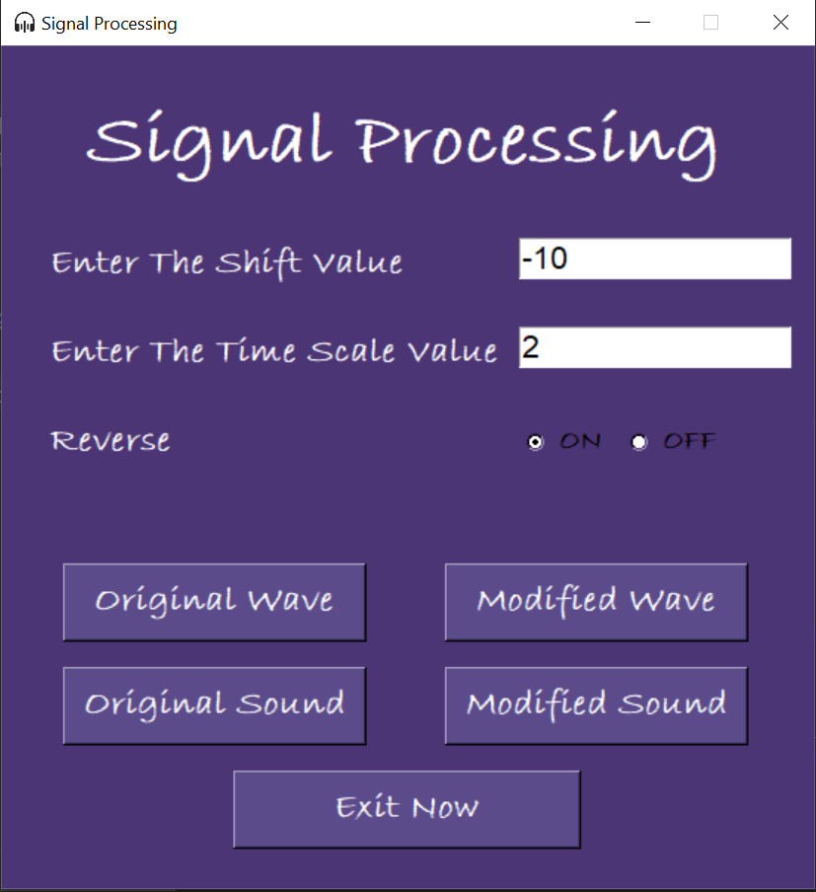
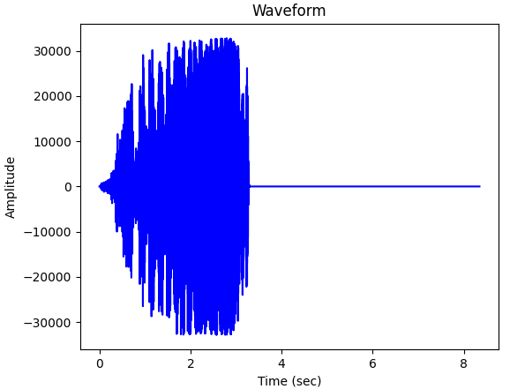

Slide 10
Thank you!

